Slide 1
The Author-topic model for authors and Documents
Team Doctrina Apparatus

Slide 2
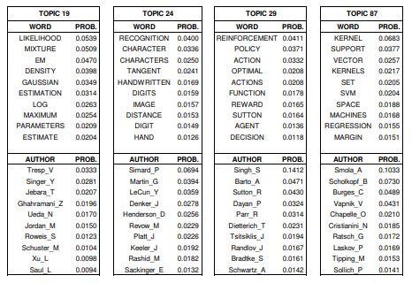
Author-topic model
This model provides simple probabilistic model for exploring the relationships between authors, documents, topics and words.
Topic is defined as probability distribution over words and is discovered automatically with unsupervised learning.
At the same time, author’s interest to that topic is simultaneously quantified.

Slide 3
Topic model and author model
For author model, the interests of authors are directly modeled with probability distributions over words.
For topic model, there is a topic distribution for a document and word distribution within that topic.
Document d
TOPIC | PROB.
1 | 0.05
2 | 0.04
3 | 0.03
4 | 0.02
5 | 0.01
Author: John_Ho
WORD | PROB.
machine | 0.0823
learning | 0.0497
upsupervised | 0.0234
supervised | 0.0226
python | 0.0224
C++ | 0.0166
natural | 0.0151
language | 0.0134
processing | 0.0131
continuous | 0.0121
Topic 1
WORD | PROB.
machine | 0.0823
learning | 0.0497
upsupervised | 0.0234
supervised | 0.0226
python | 0.0224
C++ | 0.0166

Slide 4
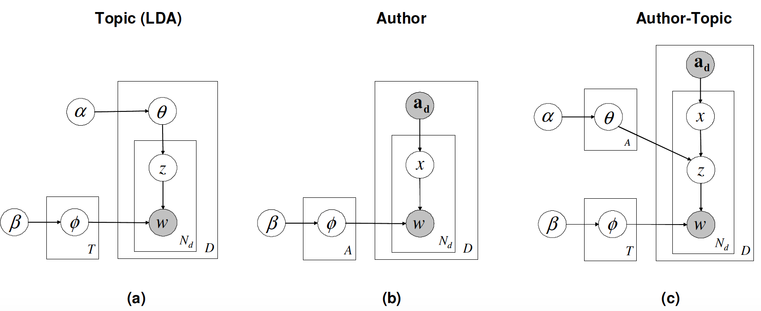
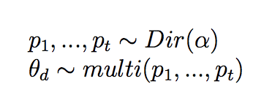
Model description

Slide 5
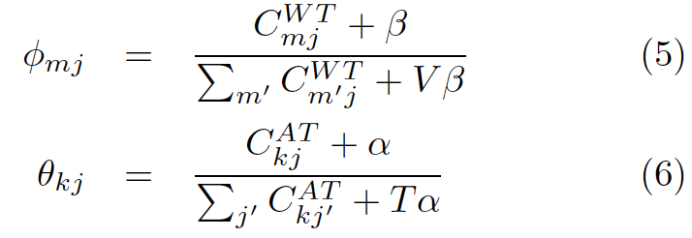
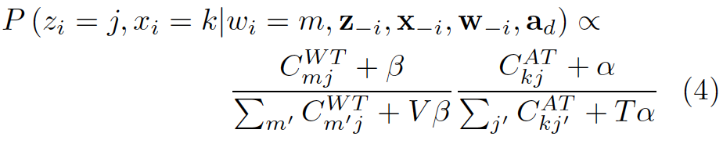
Parameter estimation by Gibbs sampling
Step 1. Assigning words to random topics and authors
Step 2. Apply Equation (4) to every word in the text and do assignment accordingly
Step 3. Repeat step 2, 2000 times and save the word by topic matrix (5) and author by topic matrix (6)

